Slide 1
Property Tax

Slide 2
Topics to be discussed
- General introduction to property tax
- Comparison of taxing entities
- 1% annual increase
- Banked capacity

Slide 3
City tax revenues: a four-legged stool
2022 (LAST FULL YEAR) REVENUES SHOWN
Solid waste tax
33%
$ 3,380,000
Property Tax
19%
$ 2,000,000
Sales Tax
39%
$ 4,000,000
Utility Tax
10%
$ 1,000,000

Slide 4
General introduction
- Mayor’s budget does not anticipate taking annual 1% property tax increase
- Mayor’s budget does not anticipate taking any banked capacity
- Council action: November 20th (public hearing)

Slide 5
Add a Slide Title - 3
Property Tax Levy
Core Revenue – one of the largest sources of income for the general fund.
Levy Lid - property tax increase limited to 1% or the rate of inflation, whichever is lower.
Levy Lid Lift – to increase property tax above the limit, voter approval required.

Slide 6
Add a Slide Title - 4
The City of Ferndale has 4 different Tax Code Areas.
The average Ferndale property owner pays $8.18 per $1000 AV annually in all property taxes combined.
Of this $8.18 per $1000 AV the City receives roughly 8.6%, whereas the Ferndale School District receives over 29% and is the largest tax collector

Slide 7
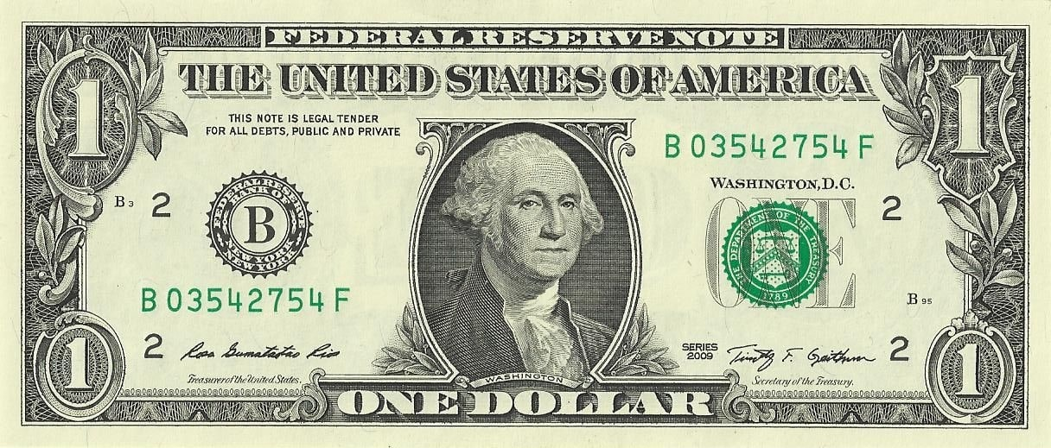
COUNTY
10%
CONSERVATION FUTURES .3%
LIBRARY
3.6%
FERNDALE SCHOOL DISTRICT: 29%
CITY
8.6%
WASHINGTON STATE (SCHOOLS): 29.6%
FLOOD CONTROL: 1.5%
CEMETERY .4%
FIRE DISTRICT
11.6%
PORT
1.8%
EMS
3%

Slide 8
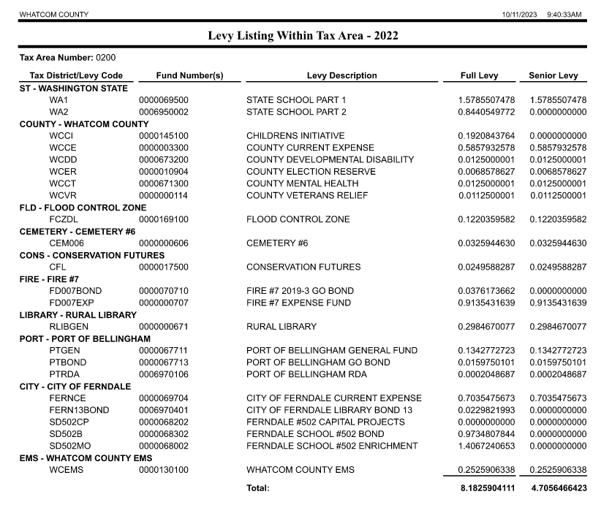
Add a Slide Title - 4

Slide 9
PROPERTY TAX: A COMPLICATED PROCESS
FIRE
CITY
TOTAL REQUESTED LEVY AMOUNT
MISC TAXING DISTRICTS
ASSESSOR DETERMINES IF OVERALL REQUESTED LEVY EXCEEDS MAXIMUM AUTHORIZED; REDUCES IF NECESSARY
SCHOOLS

Slide 10
Add a Slide Title - 4
Core Revenue
2024 Regular Levy Request
2023 levy plus 1% = $2,028,300.70
New Construction = 51,424.81
State Assessed Property Previous Year = 582.19
Refund Amount = 8664.05
Total Levy Request = $2,088,971.75

Slide 11
Add a Slide Title - 4
Core Revenue
2024 Regular Levy Request
2023 levy (without 1%) = $2,008,218.51
New Construction = 51,424.81
State Assessed Property PY = 582.19
Refund Amount = 8664.05
Total Levy Request = $2,068,889.56

Slide 12
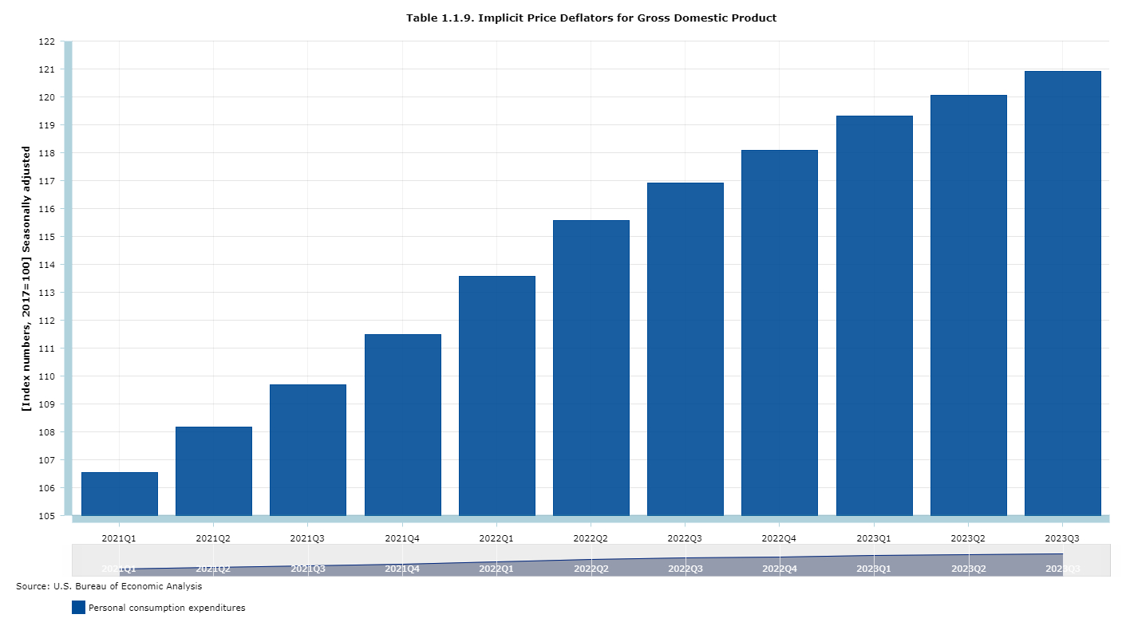
Add a Slide Title - 4
Levy Lid
1% or rate of inflation (whichever is lower)
Inflation means the percentage change in the Implicit Price
Deflator for personal consumption expenditures (IPD) RCW 84.55.005.
IPD is a figure compiled by the
Bureau of Economic Analysis
(BEA) used to measure inflation.
For 2024, IPD is 3.670%

Slide 13
Add a Slide Title - 4
Levy Lid
1% or rate of inflation
(whichever is lower)
Exception
If the IPD is below 1%, the City may adopt a
resolution of “substantial need” to increase the levy
amount to the 1% limit.

Slide 14
Increase per Household for 1% limit $20,082.19
Assessed Value: Additional Annual Tax:
$400k $2.37
$450k $2.67
$500k $2.97
$550k $3.26
$600k $3.56
$650k $3.86
$700k $4.16
$750k $4.45
$800k $4.75
$850k $5.05

Slide 15
Increase per Household for 1% limit & full refund $28,746.24
Assessed Value: Additional Annual Tax:
400k $3.40
$450k $3.82
$500k $4.25
$550k $4.67
$600k $5.10
$650k $5.52
$700k $5.95
$750k $6.37
$800k $6.80
$850k $7.22

Slide 16
Add a Slide Title - 4
Average Washington State 2-Person Household
Non-essential: Annual Spending:
Coffee $2,200 (monthly $183)
Streaming Services $648 (monthly $54)
Amazon $2,208 (monthly $184)
Alcohol $2,248 (monthly $187)
Eating Out $3,934 (monthly $328)

Slide 17
ANYTOWN, WASHINGTON
HIGHEST LAWFUL LEVY (HLLA)
MAXIMUM BANKED CAPACITY (1% ABOVE HLLA)
BANKED CAPACITY
ACTUAL PROPERTY TAX LEVY REQUESTED
RECESSION
1985
2023

Slide 18
Current Banked Capacity Maximum Levy Amount : $3,030,851.07
This is also known as the 1% Increase over HLLA (Highest Lawful Levy since 1985).
Of the 1% Increase over HLLA (Banked Capacity Maximum Levy Amount), the maximum amount that the Council could decide to utilize in 2024 without going to voters is $1,022,632.56 (Increase Amount: also known as available Banked Capacity). The formula used for this is (1% Increase Over HLLA/PYAL)-1=Percent Increase then PYAL*Percent Increase=Increase Amount.
Banked Capacity is not a savings account and there is no guarantee of future use. Banked Capacity fluctuates year to year based upon current market values. If the market preforms well the Banked Capacity rises, however if the market falls then so does the Banked Capacity. Banked Capacity can even disappear altogether.

Slide 19
Add a Slide Title - 4
Banked Capacity vs 1% Is Not Apples to Apples
The 2023 Banked Capacity Increase due to not taking the 1%= $994,793.58
Had the City taken the full PYAL with the 1% Increase of $19,322.35. The Banked Capacity would have still grown based on new construction growth just not to the extent that it did.

Slide 20
The Fire District 7 Annexation and Banked Capacity
When the City Annexed the Fire District in, the City chose to not take its full percentage of property taxes that it had been collecting previously as the City new that the Fire District would be taking a percentage. In not taking it’s maximum % the City allowed Ferndale property taxes to remain the same % with the Fire District addition. This % that the City chose to no longer take annually began applying to the City’s Banked Capacity based on the AV (Actual Value).
Also, the Fire District and Library get to take their amounts first. If they were to take their maximum allowed amount this could significantly reduce the City’s property tax revenue. This has never occurred.

Slide 21
Add a Slide Title - 4
“What does this mean for me?”
- Why are my taxes different from my neighbor?
- My assessed value increased – will my taxes increase?

Slide 22
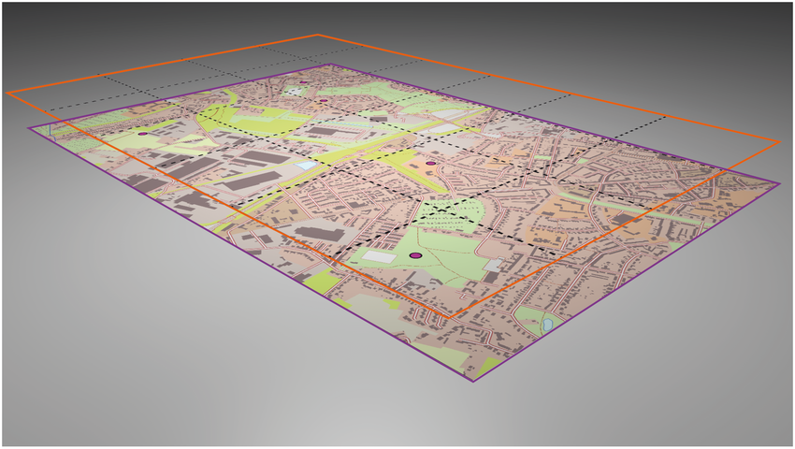
Add a Slide Title - 4
“Why are my taxes different from my neighbor?”

Slide 23
Add a Slide Title - 4
“Why are my taxes different from my neighbor?”

Slide 24
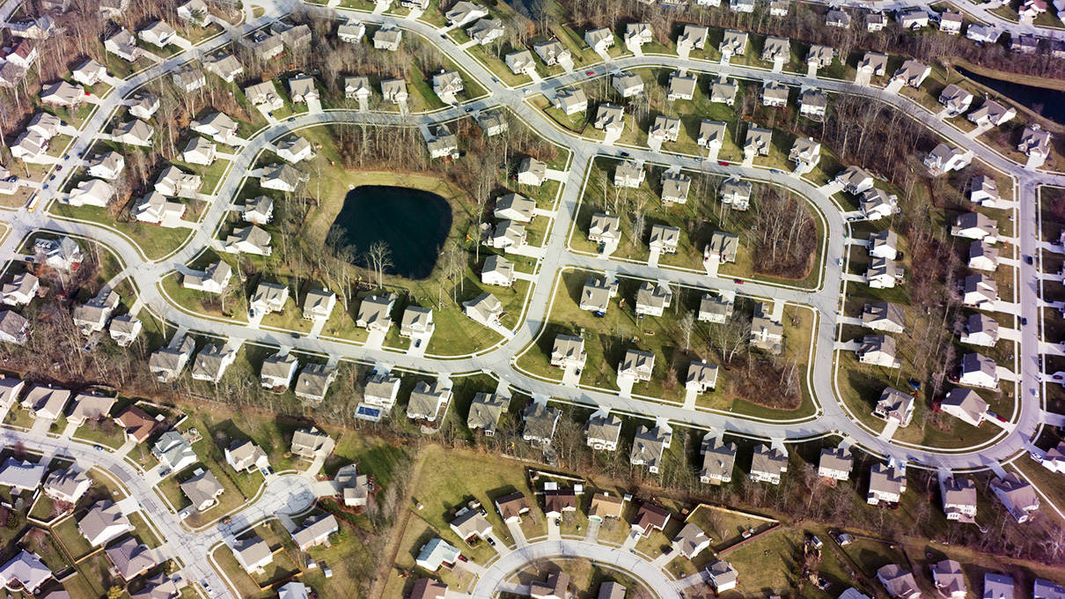
Add a Slide Title - 4
“Why are my taxes different from my neighbor?”
$500K
OVERALL ASSESSED VALUE OF AREA DETERMINED BY ASSESSOR
$500K
$500K
$500K
OVERALL TAXING DISTRICT AV: $10,000,000
(20 HOMES @$500K)

Slide 25
Add a Slide Title - 4
“Why are my taxes different from my neighbor?”
$500K
2. ASSESSOR RECEIVES REQUESTED LEVY AMOUNTS
3. MILL RATE” (TAX PER $1,000 ASSESSED VALUE) DETERMINED BY ASSESSOR
$500K
$500K
$500K
OVERALL TAXING DISTRICT AV: $10,000,000
(20 HOMES @$500K)

Slide 26
Add a Slide Title - 4
“Why are my taxes different from my neighbor?”
$500K
2. ASSESSOR RECEIVES REQUESTED LEVY AMOUNTS
SCHOOLS: $3,000
STATE: $3,000
FIRE DISTRICT: $1,500
CITY: $800
OTHERS: $1,700
$10,000 TOTAL
$10,000,000/$10,000 = $10/AV TAX (MILL RATE)
$500K
$500K
$500K
OVERALL TAXING DISTRICT AV: $10,000,000
(20 HOMES @$500K)

Slide 27
“Why are my taxes different from my neighbor?”
$500K
$500K
$500K
$500K
500 1,000’S
MILL RATE: $10 per $1,000
500x$10 = $5,000 PROPERTY TAX
(CITY SHARE: $400)

Slide 28
“Why are my taxes different from my neighbor?”
$500K
$500K
$500K
$700K
$5,000*
$5,000*
$5,000*
$7,000
* IF OVERALL LEVY REMAINS IDENTICAL, ACTUAL MILL RATE/ TAXES MAY GO DOWN

Slide 29
“My assessed value increased! They’re raising my taxes!”
$700K
$700K
$700K
NOT NECESSARILY – MORE LIKELY THE MILL RATE WILL BE ADJUSTED
- THERE IS NOW MORE ASSESSED VALUE IN THE DISTRICT (THE DENOMINATOR)
- THE OVERALL LEVY AMOUNT (NUMERATOR) MAY NOT HAVE CHANGED, AND WILL NOT HAVE CHANGED AS DRASTICALLY
BEFORE: $10,000/$10,000,000 = $10 PER $1,000 MILL RATE
AFTER: $10,000/$14,000,000= $7.14 PER $1,000 MILL RATE (ASSUMES NO OTHER CHANGES)
$5,000*
$4,998

Slide 30
Conclusions / Review
Questions?

