Slide 1
FY2024 Budget Presentation
March 27, 2023

Slide 2
Agenda
FY2023 Budget Update
General Budget Process Review
FY2024 Budget Context
City Administrator’s Presentation

Slide 3
FY2023 Budget Update
Through February, 2023

Slide 5
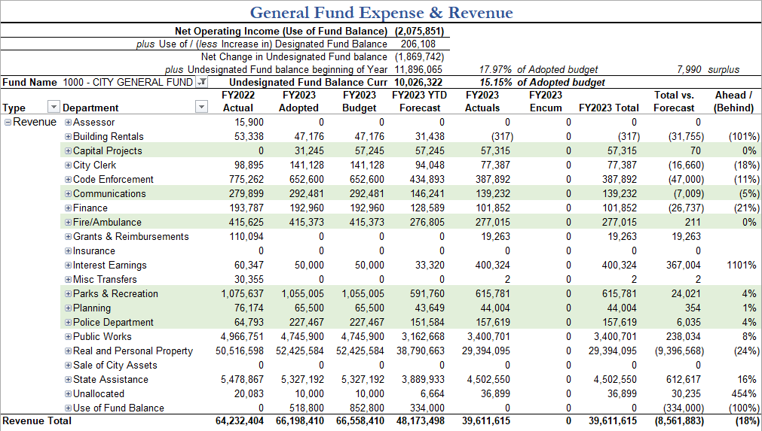

Slide 6
General Budget Process Review
An Overview
Notes:
I will start out the presentation with the big picture, strategic planning, and economic context and then I will turn it over to Bryan to present the City Administrator’s budget in detail.

Slide 7
Introduction to the Budget
What is a Municipal Budget?
  All of the expenses and revenues that the City of Saco needs to provide quality services for its citizens for a full fiscal year
What is a Fiscal Year?
  The City’s Fiscal year is July 1st - June 30th
  The “Year” is the year of the last day of the year
  Example: Fiscal Year 2024 goes from July 1, 2023, to June 30, 2024
What is the Property Tax Rate?
  The City calculates taxes by multiplying the tax rate by the property value
What is the Mil Rate?
  The Mil Rate is the property tax rate per $1000 of property value
  In Fiscal Year 2023, the Mil Rate was $18.33
Notes:
Before we get into the details of this year’s annual budget…

Slide 8
Phase 1: Maintenance of Effort
The City Administrator and Finance Director work with Departments to establish the Maintenance of Effort Budget
Maintenance of Effort: Doing the same thing this year that we did last year
Doing the same thing will cost a little more! Why?
  Cost of Living increases, Inflation, Contracted increases
Doing the same thing may cost a little less! Why?
  One-time expenses from the previous year are excluded
  Line items with budgets higher than historical trends were analyzed and adjusted down
Notes:
The Budget Development process is broken down into 5 phases…

Slide 9
Phase 1: Maintenance of Effort Budget
Last Year’s Approved Budget
+ Year 2 of Last Year’s Approved Capital Plan
+ Contracted Increases
+ Cost of Living Increases
- One Time Expenses
- Other Savings (including New Revenues)
Maintenance of Effort Budget

Slide 10
Phase 2: City Administrator’s Budget
Departments may submit requests to expand services or increase department size
City Administrator reviews these requests and determines his Final Budget
Maintenance of Effort Budget
+ Increases
- Other Changes
City Administrator’s Budget
Notes:
The next phase is development of the City Administrator’s budget. As part of this process…

Slide 11
Phase 3: Budget Presentation
Finance compiles the City Administrator’s Budget Book
City Administrator and Finance Director present the Budget to Council
School Superintendent and Finance Director present School Budget
Departments present their individual budgets to Council
The Public can view the presentations and offer public comment during the formal public hearing
Council works with Finance to draft Amendments
Phase 4: Budget Deliberation
Notes:
That is the part of the budget process that we are doing tonight!...

Slide 12
Phase 5: Budget Approval
Council reviews and votes on the Fee Schedule
Council reviews and votes on the Capital Plan
Council reviews and votes on the School Budget
Council reviews and vote on the Municipal Budget
  Amendments proposed and approved by line item
Finance enters the final budget into financial system
Finance compiles the final Approved Budget Book
Notes:
The last phase is Budget Approval. This is one of the most important Council meetings of the year and is mandated to occur on the second Monday in May per City Charter.

Slide 13
Budget Process
1
Maintenance of Effort Budget Established
2
Proposed Increases Reviewed
3
Budget Presented to Council
City Administrator’s Budget Finalized
4
Council Reviews the Budget
5
Council Approves the Budget

Slide 14
How to Read the Budget Book
Letter of Transmittal
Introduction
City of Saco Introduction
Fiscal Summary
Capital Program
Department Budgets
Other Budgeting Units
Other Governmental Funds
Water Resource & Recovery Department
Notes:
The Finance Department has issued the City Administrator's FY2024 Budget Book. The budget book is 250 pages long – which can be intimidating! I wanted to take some time to talk a little about what is in each section.
The letter of transmittal written by the City Administrator as an introduction to his annual budget. It provides an explanation of what was or was not approved in the budget and why.
The introduction provides a basic overview of the budget process in the City of Saco as well as definitions for common terminology. I definitely recommend taking the time to read this helpful background information, even if you have been through a budget process in the past.
Section 1 contains an introduction to the City of Saco, including some important demographic info, as well as names and contact information for department heads and elected officials
Section 2 contains several tables that summarize the budget in different ways. This is to provide different options for how the reader may want to analyze the data. This year, it also includes the fee schedule. This is also where the City summarizes its headcount. The last table in this section provides a forecast for how the unassigned fund balance is expected to change.
Section 3 is the 5 year capital plan as required by City Charter. This is also the section where the City reports on debt payments and new debt for the coming fiscal year.
Section 4 contains the individual departmental budgets. Each department has invested time in a thoughtful written introduction to talk about accomplishments from the past year and any ongoing departmental challenges. I definitely recommend taking the time to read through these introductions in preparation for each departmental presentation over the coming weeks. The narratives may spark questions or ideas you wish to discuss with the department heads at their scheduled budget presentation. Each department section contains a summary budget, which shows all line items organized into the same 15 categories, to create some ability to compare departmental expenses between departments. Increases approved in the departmental budget are mentioned here as well. Finally, each departmental section has the line item detail support for the budget.
5. Other budgeting units – this section covers items that are not part of a City department such as Fringe Benefits, Contingency, Insurance, etc. This is also where you can find a complete list of the City’s supported entities and review their annual funding request letters. Please note that actual funding may vary from the entity’s request. Since not all supported entities are given the opportunity to present to Council during the budget process, I recommend taking the time to read through these letters. They provide some great context about the hard work that local organizations are doing in our community.
6. Other Governmental Funds. The City maintains a number of governmental funds on its balance sheet for reporting revenues and expenditures related to specific non-tax funding mechanisms with special controls. This section includes summary reports for only those funds that have expenses budgeted in the coming year. A line item detail report at the end of the section reports all activity across all funds at the line item level. This is also where the planned expenditures for ARPA are presented and where the Economic Development budget is presented, including all planned TIF expenditures.
7. WRRD. WRRD Revenues and Expenditures are budgeted in a special kind of fund known as an Enterprise Fund. This is because the amount that users pay into the WRRD is directly related to their actual usage. For this reason, WRRD is budgeted and reported more like a private sector enterprise. However, Council still approves the WRRD budget and rates on an annual basis.

Slide 15
Explanation of Budget Columns
History of Actual Expenditures

Slide 16
Explanation of Budget Columns
FY2023 Approved Budget
Year to Date Actual Expenditures

Slide 17
Explanation of Budget Columns
FY2023 Approved Budget
+ Year 2 of Capital Plan
+ Contracted Increases
+ Cost of Living Increases
- One Time Expenses
- Other Savings
Maintenance of Effort Budget

Slide 18
Explanation of Budget Columns
Percent Difference between FY2023 Approved and Maintenance of Effort
Dollar Difference between FY2023 Approved and Maintenance of Effort

Slide 19
Explanation of Budget Columns
Maintenance of Effort Budget
+ Increases
- Other Changes
City Administrator’s Budget

Slide 20

How to Read This Budget Book
Start with the total numbers at the bottom of each table.
Use the Charts/Graphs in each section as a guide.
Look for numbers that are changing the most.
Use a highlighter.
Write down your questions. You can send your questions to budget@sacomaine.org.
(Have a cup of coffee or tea handy!)
Notes:
As I had mentioned before – 250 pages can be intimidating. Here are some tips for how to read the budget book.
Start with the total numbers at the bottom of each table. This give you the “big picture” in terms of how much is changing from Fiscal Year 2022 to Fiscal Year 2023.
Use the Charts/Graphs in each section as a guide for understanding how the overall numbers have changed from year to year.
Look for numbers that are changing the most. What numbers are going up more than other numbers? These are the major “budget drivers” that are affecting the taxes for next year.
Use a highlighter to keep track of particular numbers or items that you are interested in learning more about.
Write down your questions in a notebook or write your questions directly on your copy of the City Administrator’s Budget Book. Refer back to these questions during the departmental presentations or send your questions to budget@sacomaine.org.
I’m going to pause here and see if there are any questions about the format of the budget book or the budget process.

Slide 21
The Context
Fiscal Year 2024 Budget
Notes:
This next section covers the big picture, strategic planning, and economic context and then I will turn it over to Bryan to present the City Administrator’s budget in detail.

Slide 22







Cycle of Sustainability
Population
Property Values
Tax Revenue
Best-in-Class City Services
Strong Infrastructure, Safe Neighborhoods, Great Schools, etc
Notes:
I would like to kick off this year’s budget conversation, as I have the past few years with the Cycle of Sustainability. I developed the Cycle of Sustainability as a way to model the complex interdependency of population growth, property valuation, and tax rates on municipal service levels and financial health. I find it to be a useful tool for visualizing strategic challenges to a healthy budget from year to year. It creates shared language in understanding the role of budgeting in maintaining a strong community. Those of you who have been on the Council for a couple of years could probably give this section of the presentation. But, for those of you that are new and for those citizens tuning into a budget presentation for the first time, I would like to take a couple of minutes to walk through the model, step by step.
The model begins with best in class city services…

Slide 23
Council Focus Areas
Best-in-Class City Services
Notes:
Council prioritized how these best in-class-services should be managed through a strategic planning exercise that was approved earlier this month (March, 2023)

Slide 24
Council Focus Areas
1
2
Best-in-Class City Services
3
Notes:
Council Focus Areas prioritized Financial Stability, Schools & Infrastructure, and Economic Opportunity. The remaining focus areas were prioritized as you see on the wheel in order clockwise.

Slide 25
Multi-Point Prioritization Process
Council Goals | Comp Plan Principals / Top 5 / Next 5 | ARPA Priorities | Citizen Satisfaction Concerns
1. Financial Stability | Strengthen our City’s fiscal position / Top 5 / Next 5 |  | Taxes / taxes for fixed income Spending tax dollars wisely
2. Schools & Infrastructure | Invest in our schools & infrastructure / Top 5 / Next 5 Design a connected mobility system / Next 5 | 2. Capital Funding for Right of Way 12. Capital Funding for Public Safety | Traffic / congestion / speeding School concerns
3. Economic Opportunity | Expand economic opportunity for all / Top 5 | 6. Economic Assistance | Employment opportunities
4. Growth & Innovation | Provide a variety of housing options / Top 5 / Next 5 | 7. Smart Growth 3. Housing Support | Pace of development / growth Home affordability
5. Livable Community | Enhance our downtown as the lively core of our community / Next 5 Promote health and well-being | 8. Healthy Childhood 1. Capital Funding for Parks & Open Spaces 4. Public Health Services | Restaurants & culture venues Accessible open space
6. Governance
7. Environmental Sustainability | Grow our environmental Stewardship Build resiliency / Top 5 | 10. Wastewater Treatment Plant 5. Environmental Sustainability
8. Transparency & Engagement |  | 9. Capital Funding for IT Infrastructure | Perception of influence over community decisions
9. Organizational Excellence |  | 11. Hazard Pay
Notes:
Of course, council focus areas are not the only strategic planning tool in our toolbox. We have just received State approval on the City’s comprehensive plan, with it’s top five and next five priorities. We also are working through the 2nd year of ARPA budgeting and now we have the results of the Citizen satisfaction survey.

Slide 26

Cycle of Sustainability
Strong Infrastructure, Safe Neighborhoods, Great Schools, etc
Population
Property Values
Tax Revenue
Best-in-Class City Services
Other Revenue
Tax Revenue
Tax Revenue

Slide 27
Cycle of Sustainability
Population
Property Values
Other Revenue
Best-in-Class City Services
Tax Revenue
Strong Infrastructure, Safe Neighborhoods, Great Schools, etc
Tax Revenue

Slide 28
Cycle of Sustainability
Population
Property Values
Other Revenue
Best-in-Class City Services
Tax Revenue
Strong Infrastructure, Safe Neighborhoods, Great Schools, etc
Tax Revenue

Slide 29
Cycle of Sustainability
Population
Property Values
Other Revenue
Best-in-Class City Services
Tax Revenue
Strong Infrastructure, Safe Neighborhoods, Great Schools, etc
Tax Revenue

Slide 30
Cycle of Sustainability
Population
Property Values
Other Revenue
Best-in-Class City Services
Tax Revenue
Strong Infrastructure, Safe Neighborhoods, Great Schools, etc
Tax Revenue

Slide 31
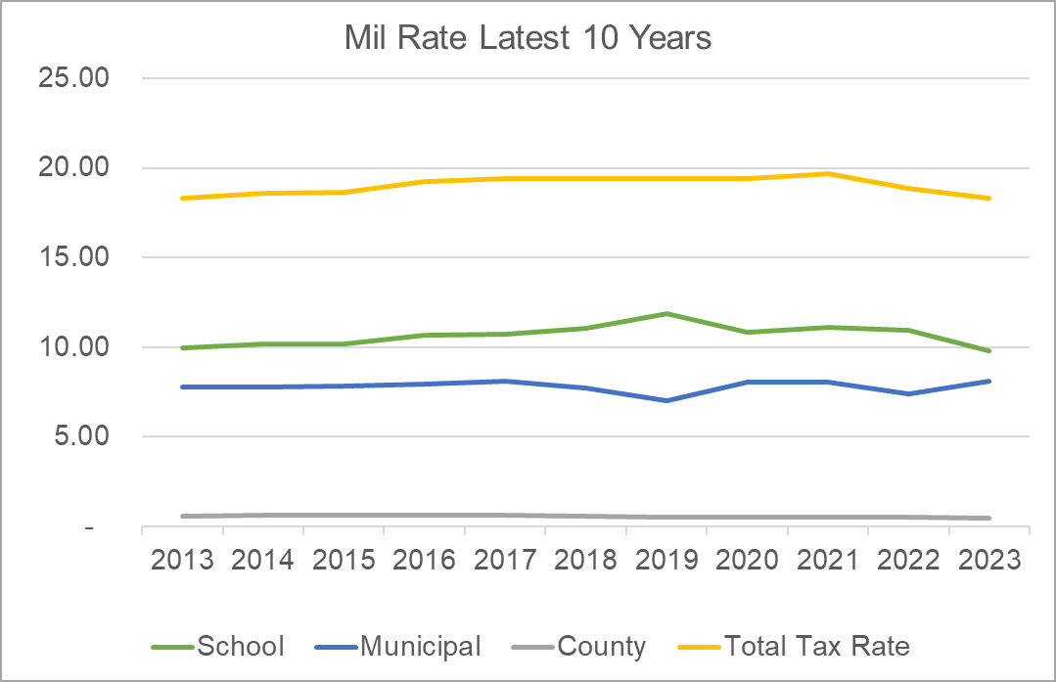
Mil Rate Has Been Very Stable
Notes:
In fact, as you can see in this chart, the Mil Rate has remained extremely stable over the past 10 years.

Slide 32
FY2024 Challenges
Property Values are rising extremely fast
Population
Property Values
Other Revenue
Best-in-Class City Services
Tax Revenue
Tax Revenue

Slide 33
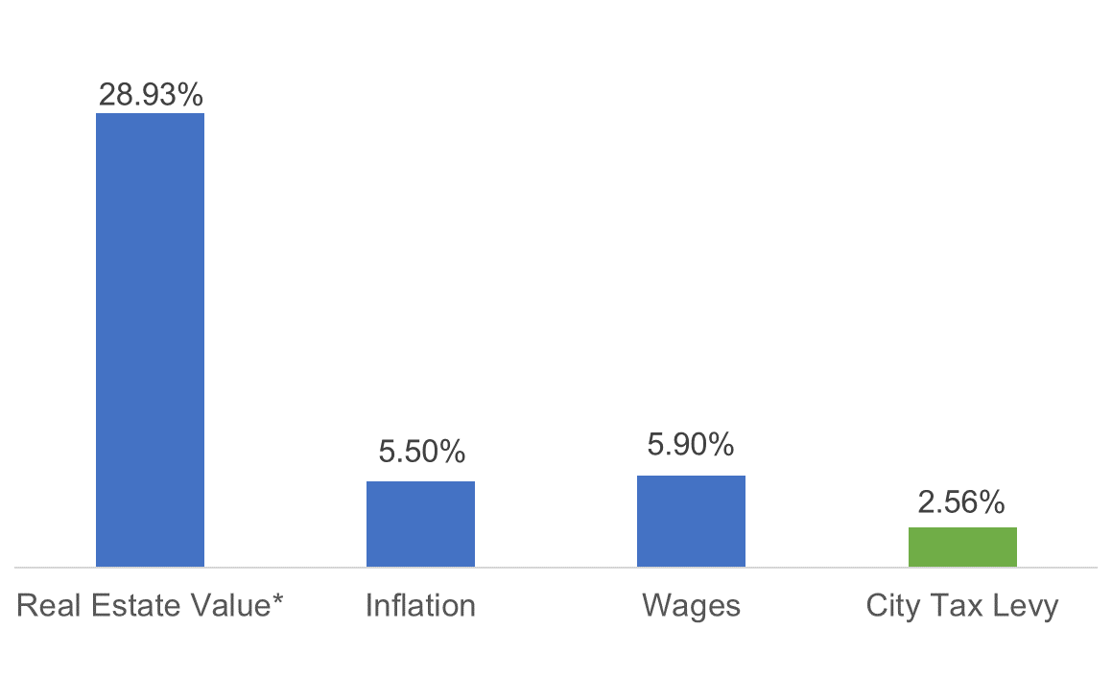
Cost Pressures for Citizens
The City has offset cost increases with $1.7 million in interest earnings and non-tax revenues
* Two year % increase less 12% adjustment in FY23
Source: Portland : New England Information Office : U.S. Bureau of Labor Statistics (bls.gov)
Notes:
Under normal circumstances, property value increases would be an indication of how fast the municipal budget would grow. However, we are looking at valuation increases of about 30%. Inflation is putting pressure on citizens’ budgets at 5.5% year over year while wages regionally are up 5.90%. In consideration of the pressure facing our Citizens, the City Administrator has put forward a budget that is just 2.56% increase on the net tax levy for our citizens. In other words, the actual amount of taxes citizens will pay towards municipal services is up just 2.56%. We are proud of this very responsible increase. City cost increases overall are up over 5%, but those increase are offset by $1.7 million in new, non-tax revenues, most notably a record setting year for interest earnings.

Slide 34
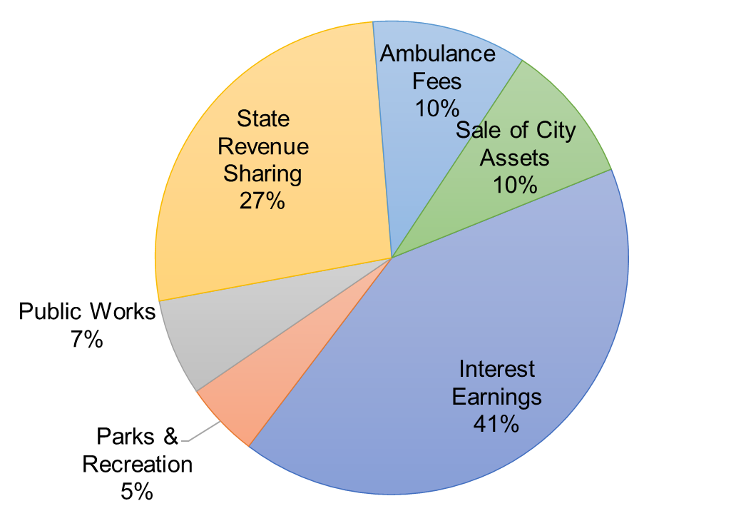
Found Revenues to Offset Taxes

Slide 35
FY2024 Challenges
Population
Property Values
Other Revenue
Best-in-Class City Services
Tax Revenue
Tax Revenue diverted to TIFs
Tax Revenue

Slide 36
FY2024 Challenges
Population
Property Values
Other Revenue
Best-in-Class City Services
Tax Revenue
Utilities cost increases are far out-pacing inflation
Tax Revenue

Slide 37
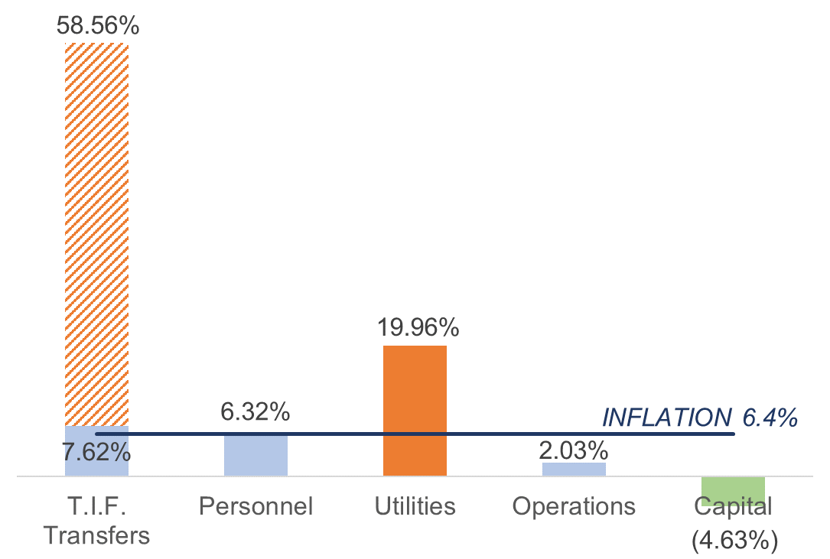
Cost Pressures for City of Saco
Return funds from TIF districts that cannot be spent on qualified projects
Contracts that stabilize utilities while the City looks for alternative energy sources
Notes:
Personnel contributed 63% of cost increase for the year, but increases for existing staff were in line with inflation.
This chart is meant to illustrate unavoidable cost pressures for the City, and as such does not include City administrator approved increases

Slide 38
The Numbers
Fiscal Year 2024 Budget

Slide 39
Phase 1: Maintenance of Effort Budget
Last Year’s Approved Budget
+ Year 2 of Last Year’s Approved Capital Plan
+ Contracted Increases
+ Cost of Living Increases
- One Time Expenses
- Other Savings (including New Revenues)
Maintenance of Effort Budget

Slide 40
Phase 1: Maintenance of Effort
Capital Plan netted savings of $160K with TIF Shifts
Contracted Increases
  Heating Fuel up 4%
  Gas, Diesel, and Electricity up 50%
  IT & Finance software fees
  Investment services (offset by interest earnings) and bank fees
  Insurance up 6%
  Contracted waste removal and garage costs up 8%
  TIF Transfers up 8% (offset by capital plan savings)
Cost of Living Increases
  Non-union employees: 5% increase
  Union employees: Matched approved union contracts
  Fringe benefits up 6% overall
Notes:
Software: Office 365 due to Exchange server change, Paychex
Investment services up $28,800

Slide 41
Phase 1: Maintenance of Effort
One-Time Items Removed
  Starter funds for the Police/Fire IMC CAD RMS project: $250,000
  General Fund Contribution for Public Safety Radio: $100,000
Savings in the Budget & Revenue Increases
  New interest earnings from investment: $864,709
  Fees adjustments: $88,170
  Excise Tax increase: $137,850
  State Revenue Sharing: $555,754

Slide 42
Phase 2: City Administrator’s Budget
Maintenance of Effort Budget
+ Increases
- Other Changes
City Administrator’s Budget

Slide 43
Phase 2: City Administrator’s Budget
Small Approved Increases (under $10K)
  Organizational Leadership Development
  Contingency for personnel
  Increased hours for department support
  Software, supplies, and printing adjustments
  Software enhancements
  Removal of online fees for e-check payments

Slide 44
Phase 2: City Administrator’s Budget
Headcount increases were approved based on detailed data analysis of service needs growth
Fire Department: Two Fire/EMS providers
  COVID-19 has revealed the critical need to invest in our public health services so that we are prepared to respond to future emergencies
Communications: Increase coordinator to full time
  Internal demands for communications support and citizen interest are increasing steadily. Making this position full-time is offset with the cable franchise revenue.

Slide 45
Phase 2: City Administrator’s Budget
Other increases to department budgets were intended to align closely with Council Goals and the Comprehensive Plan
Council Goals | Other City Administrator’s Changes – General Fund Budget
1. Financial Stability | Financial support for grants working group Contracted services in support of a city-wide revaluation New Revenue! Sell 12 School Street $200,000 New Revenue! Increase Ambulance transfers $100,000
2. Schools & Infrastructure | General Fund contribution to Traffic & Infrastructure Five Public Safety triband radio upgrades per year Computer docking stations for police department laptops Increase vehicle repairs line for police department
3. Economic Opportunity | Funding increase for Dyer Library and Saco Museum
4. Growth & Innovation | Digitize and file Planning records off-site
8. Transparency & Engagement | Dedicated work phones for sworn officers
Notes:
Helpdesk support is up 25%

Slide 46

Use of Fund Balance
Fund Balance
$25,000 | Traffic & Infrastructure Plan
$250,000 | City-wide Revaluation
$59,359 | Other one-time costs
$334,359 | Total Use of Fund Balance

Slide 47
The Numbers
 | 2023 Approved | 2024 Maintenance of Effort | 2024 City Administrator’s Budget
City Expenses | 35,746,808 | 37,528,543 | 38,196,933
School Expense* | 29,121,791 | 31,361,802 | 31,376,802
County Expense** | 1,329,811 | 1,369,705 | 1,369,705
Total Expense | 66,198,410 | 70,260,050 | 70,943,440
*This number ties to the estimate used to build the budget book. Actual School appropriation may vary.
**County Manager estimated 3% increase

Slide 48
The Numbers
 | 2023 Approved | 2024 Maintenance of Effort | 2024 City Administrator’s Budget
City Revenues | 11,489,801 | 13,096,388 | 13,516,968
Use of Fund Balance | 518,800 | 0 | 334,359
Tax Revenue | 54,189,809 | 57,163,663 | 57,092,114
Total Revenues | 66,198,410 | 70,260,050 | 70,943,440

Slide 49
The Numbers
 | 2023 Approved | 2024 Maintenance of Effort (Estimated) | 2024 City Administrator’s Budget (Estimated)
City Mil Rate | 8.09 | 6.34 | 6.32
School Mil Rate* | 9.79 | 8.14 | 8.15
County Mil Rate** | 0.45 | 0.36 | .36
Total Mil Rate | 18.33 | 14.84 | 14.83
*This number ties to the estimate used to build the budget book. Actual School appropriation may vary.
**County Manager estimated 3% increase

Slide 50
The Numbers
 | 2024 City Administrator’s Budget
City Net Tax Levy Change | 2.56%
School Net Tax Levy Change* | 7.74%
County Net Tax Levy Change** | 3.00%
Total Net Tax Levy Change | 5.36%
*This number ties to the estimate used to build the budget book. Actual School appropriation may vary.
**County Manager estimated 3% increase

Slide 51
City Administrator’s Budget Tax Levy Breakdown

Slide 52
Budgeting ARPA
American Rescue Plan Act (ARPA) of 2021

Slide 53
Background
The federal government has issued stimulus funding to states and municipalities in order to mitigate the impact of COVID-19 on local budgets
The City of Saco has been allocated $2,108,513 under the American Rescue Plan Act (ARPA) of 2021.
Council & Citizens engaged in a prioritization process for the FY2023 budget process
The ARPA plan has been adjusted in FY2024 to remove the 12 School Street project

Slide 54
Budgeting ARPA Funds
Total funding includes additional earnings from interest

Slide 55
Use of ARPA
Description | ARPA Spending Category | FY2023 Projects | FY2024 Projects
Culvert & Stream Cross Grant | Capital Funding for Right of Way | 200,000 | -
County Dredge Operations | Capital Funding for Parks & Open Spaces | 170,000 | -
Computer Replacement Annual Replacement | Capital Funding for IT Infrastructure | 100,000 | 75,000
Public Safety Comm System | Public Health Services | 100,000 | -
Ems Ambulance Equipment | Public Health Services | 82,000 | -
Mental Health First Responder | Public Health Services | 85,667 | 63,003
Cascade Falls Bridge Fy2023 | Capital Funding for Parks & Open Spaces | 60,000 | -
Pepperell Playground | Healthy Childhood | 50,000 | -
Young School Playground Drainage | Capital Funding for Parks & Open Spaces | 40,000 | -
Bypass Road Smith To Stockman | Capital Funding for Right of Way | 37,500 | -
Ppe/Gear Washer/Extractor | Public Health Services | 35,000 | -
Replacement Van | Healthy Childhood | 30,000 | -
Administrative Wages | Financial Stability | 25,000 | 30,546
It Investment For Hybrid Meeti | Capital Funding for IT Infrastructure | 20,562 | -
Climate Adaptation Action Plan | Environmental Sustainability | 15,000 | -
Public Health/Safety Recording | Capital Funding for IT Infrastructure | 12,145 | -
Age Friendly Tech | Capital Funding for IT Infrastructure | 2,500 | -
Camp Ellis Boat Ramp | Capital Funding for Parks & Open Spaces | - | 175,000
Park Storage Building Modifica | Capital Funding for Parks & Open Spaces | - | 160,000
Prentice Park | Capital Funding for Parks & Open Spaces | - | 125,000
Fire Truck Onboard Equipment | Public Health Services | - | 80,000
Decomission Firearms Range | Environmental Sustainability | - | 80,000
City-Wide Infr & Adapt Plan | Smart Growth | - | 75,000
Affordable Housing Plan | Housing Support | - | 70,000
Foss Fields Parking Lot | Capital Funding for Right of Way | - | 40,000
Fire Operations Radio Broadcas | Public Health Services | - | 40,000
Server Replacement | Capital Funding for IT Infrastructure | - | 26,729

Slide 56
Other Grant Efforts
Potential Grants
27 Grants, $5.9 million
Qualified Grants
20 Grants,
$4 million
Grant/Project Match
8 Grants,
$1.6 million
Saco has established a cross-departmental working group for grants research
This group will receive $15,000 to support efforts in FY2024
Currently 27 grants have been researched with a total of $5.9 million in potential funding
This does not include grants that were already in progress prior

Slide 57
Strategic Planning
How does the budget stack up?

Slide 58
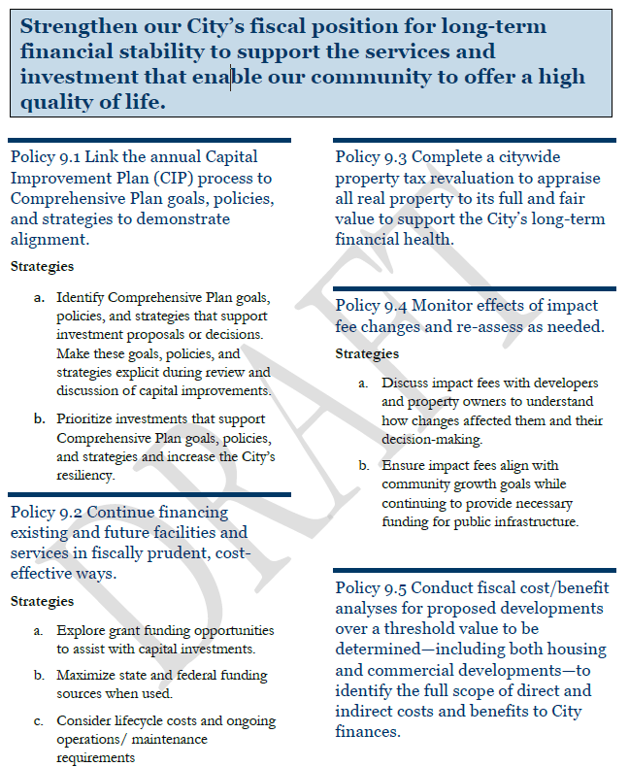
From the Comprehensive Plan
This Annual budget meets policies laid out in the Fiscal Section of the Comp Plan
Strategic Capital Planning
Significant grant funding
$250K towards a revaluation
Shared capital costs with neighbors

Slide 59
Council Goals – Top 5
Council Goals | New Initiatives Funded in the Budget
1. Financial Stability | $305,792 funding for new initiatives $1.7 million new non-tax revenues
2. Schools & Infrastructure | $741,399 funding for new capital projects
3. Economic Opportunity | $478,556 funding for new economic development and community initiatives
4. Growth & Innovation | $97,503 funding for planning initiatives, including housing
5. Livable Community | $709,992 funding for public health and open spaces

Slide 60
Budget Timeline & Presentations
FY2024 Budget

Slide 61
Budget Calendar
April 3 | Water Resource Recovery Department Police Department Economic Development & TIF Districts City Clerk Parks & Recreation Code Enforcement
April 10 | Planning Human Resources & Communications Information Technology Finance (includes Other Supported Entities, Contingency, Insurance, Solicitor, Revenue & Fee Schedule) Fire/Ambulance Department Administration
April 24 | Saco Main Street Dyer Library BSOOB Transit Age Friendly Saco Public Works & Capital Planning Assessing

Slide 62
Budget Calendar
May 1 | Public Hearing Review of Budget Motions & Amendments Council Discussion
May 8 | Budget Adoption: City & School

